Slide 1
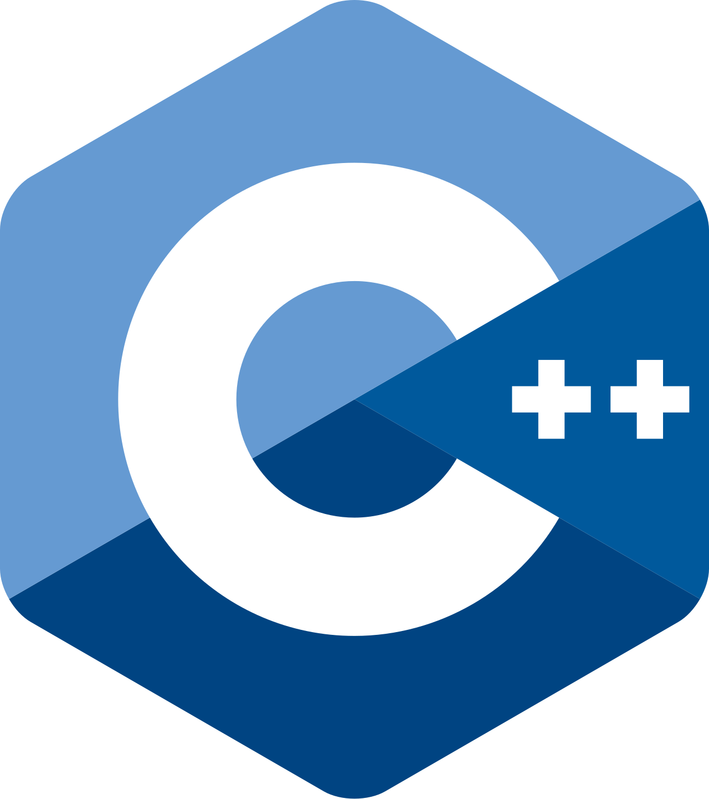

Slide 2
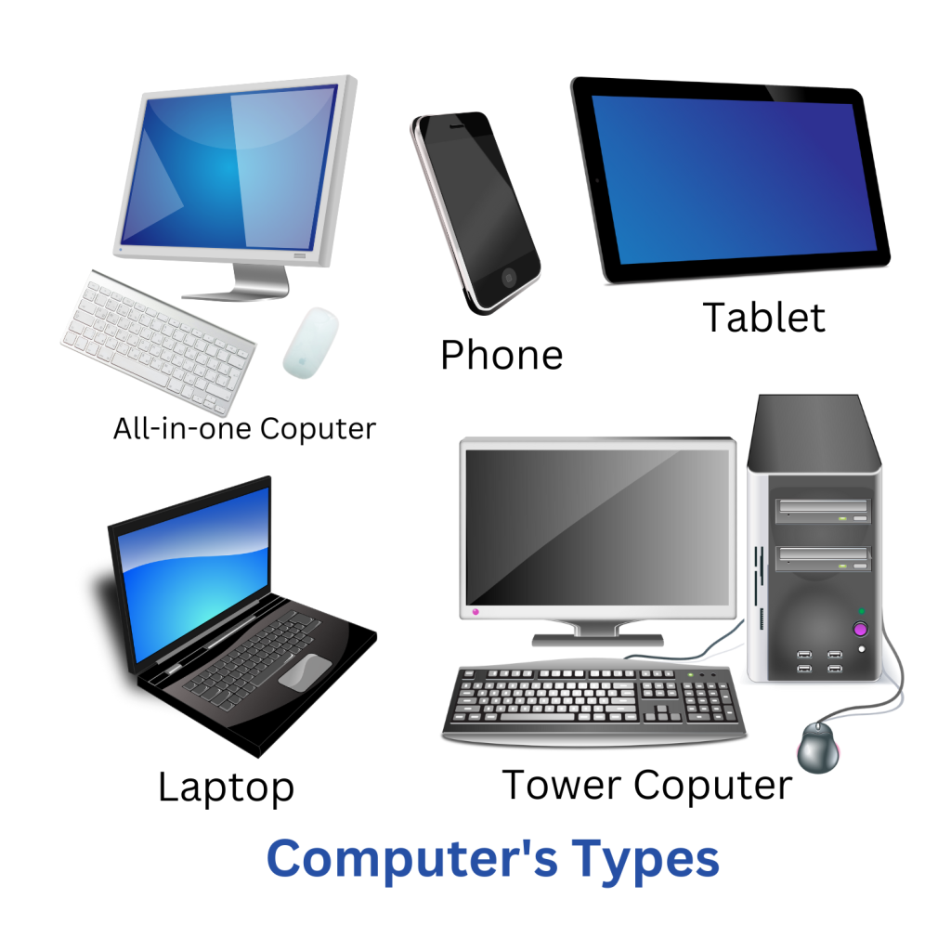
What is a computer?

Slide 3
What is computer?
A computer : is a programmable device that is used to input, store, retrieve, and processes data.

Slide 4
Computer System
Hardware : different metallic and plastic parts
Software : set of instructions

Slide 5


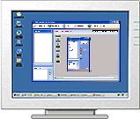
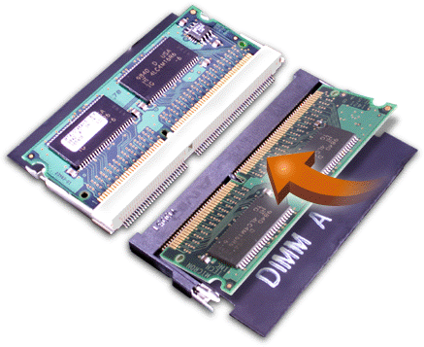
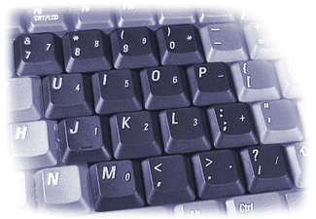
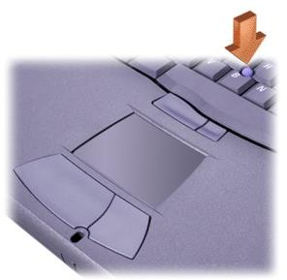

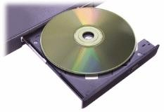
Hardware
ALU
CU
CPU
Main Memory
Output Devices
Secondary Memory

Slide 6
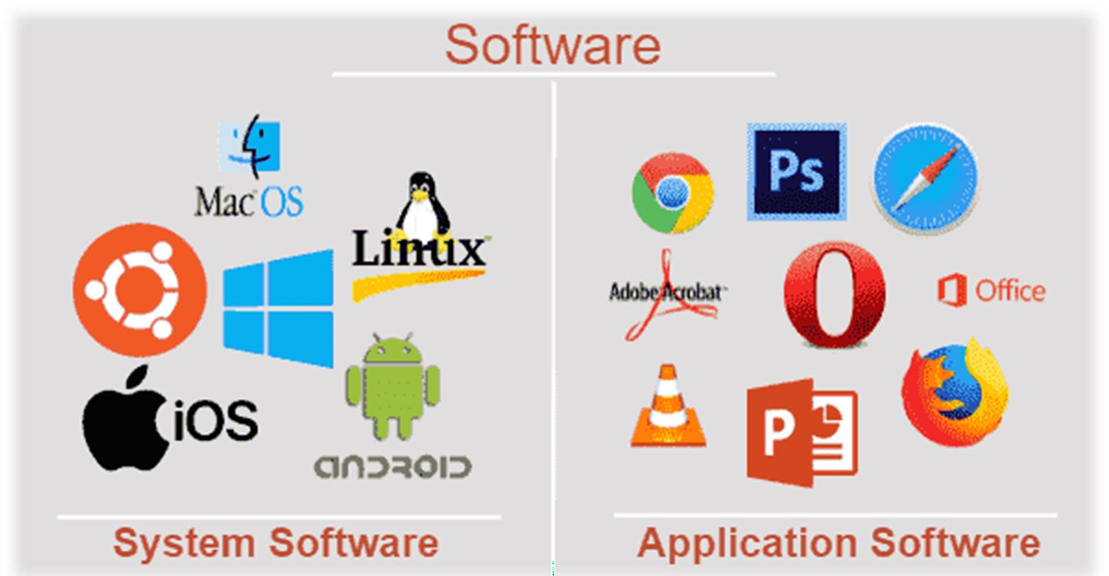
Software
Application software : Programs written to perform particular tasks for users
System software : Collection of programs to operate the computer system

Slide 7
Operating system
Operating system: The set of system programs used to operate and control a computer
Tasks performed by the OS include:
  Memory management
  Allocation of CPU time
  Control of input and output
  Management of secondary storage devices

Slide 8
What is Computer program?
A computer program : is a collection of instructions that perform a specific task when executed.
it is a set of instructions or commands that tell a computer what to do. These instructions are written in a specific programming language, such as Python, Java, C++, or JavaScript.
A program can perform a wide variety of tasks, from simple calculations to complex data processing and software applications.
Wikipedia Programming: is the process of designing and building an executable computer Program to accomplish a specific computing result.
Wikipedia

Slide 9
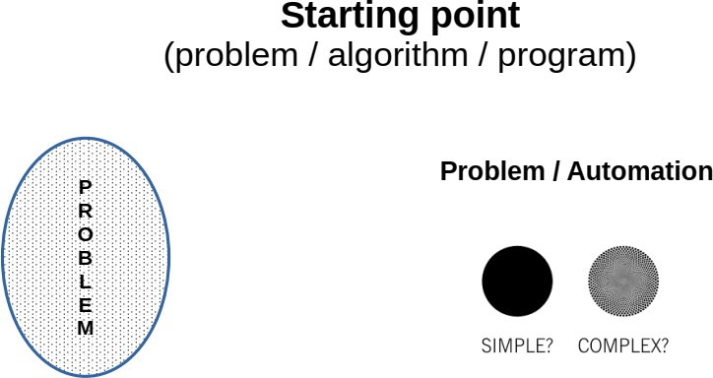

Slide 10
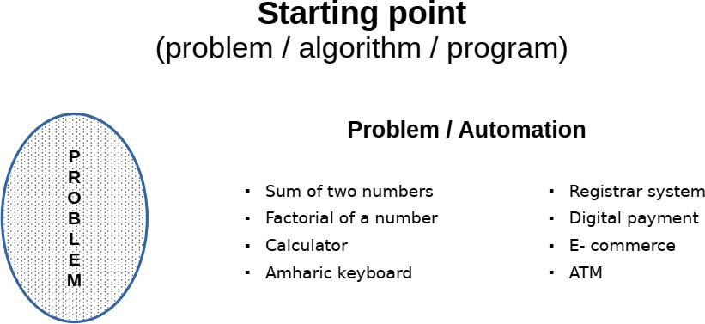

Slide 11
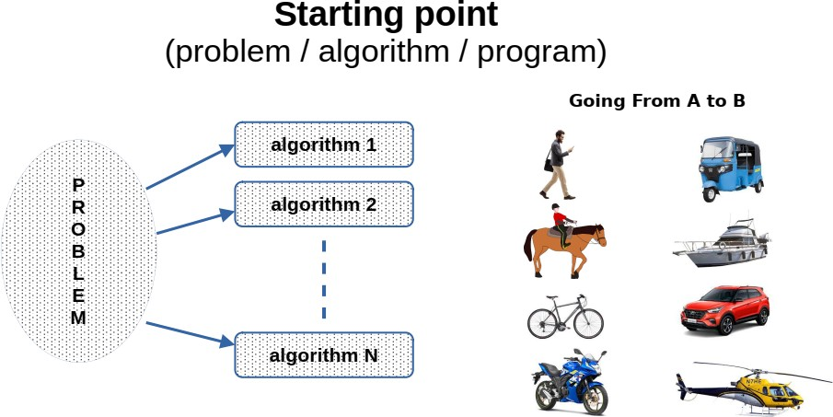

Slide 12
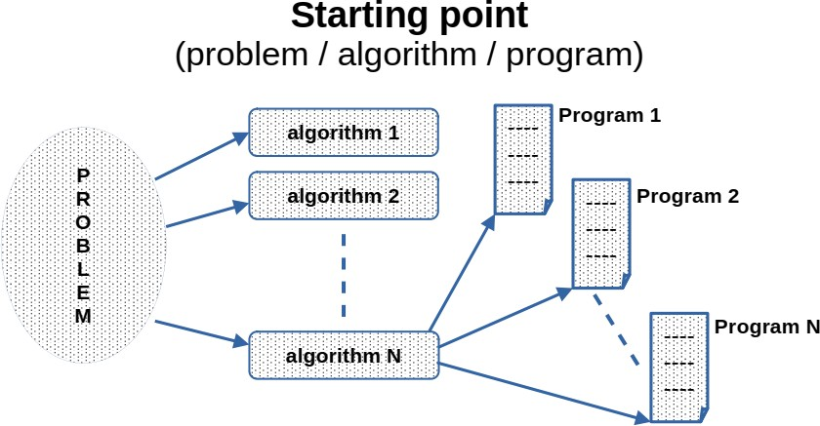

Slide 13
Programming Language
Programming language : is a formal language, which comprises a set of instructions that produce various kinds of output.
Programming languages are used in computer programming to implement algorithms.
Today there are thousands of high-level programming languages, and new ones continue to emerge.

Slide 14
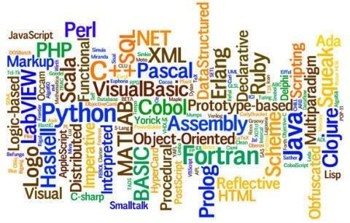
Programming Language

Slide 15
Low and High Level Languages
Low-level languages: Languages that use instructions tied directly to one type of the architecture of the computer.
  It’s typically used to write system software, such as operating systems, device drivers…
  machine language (consisting of binary code ), assembly language (uses mnemonic codes and symbols to represent the instructions)
High-level languages: Instructions resemble written languages, such as English
  Can be run on a variety of computer types
  Visual Basic, C, C++, Java, Python…

Slide 16
Low and High Level Languages
Machine language programs : only programs that can actually be used to operate a computer
  Also referred to as object codes
  Consists of a sequence of instructions composed of binary numbers
Contains two parts:
  an instruction and
  an address
Operation | Address
0010 | 0000 0000 0100
0100 | 0000 0000 0101
0011 | 0000 0000 0110

Slide 17
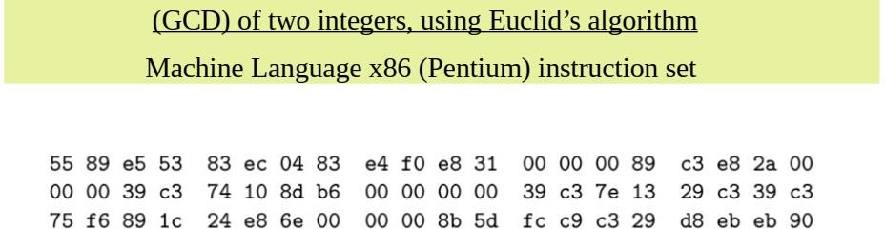
Low and High Level Languages

Slide 18

Low and High Level Languages
Assembly language programs: Substitute word-like symbols, such as ADD, SUB, and MUL, for binary opcodes
  Use decimal numbers and labels for memory addresses
  One-to-one correspondence (Usually, each line of assembly code produces one machine instruction)
  Example: ADD 1, 2
  Assemblers: Translate programs into machine language

Slide 19
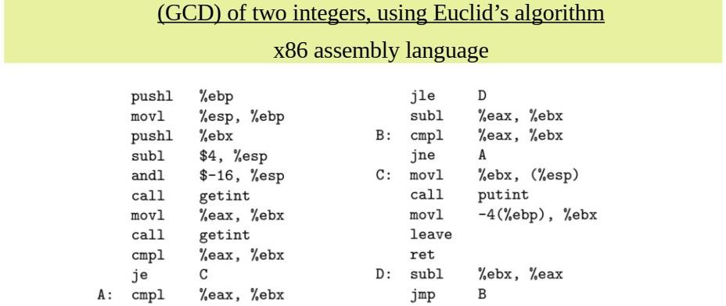
Low and High Level Languages

Slide 20
Low and High Level Languages
High level language : One-to-many correspondence
Each statement corresponds to several machine language instructions
Much easier to program than in assembly language.
Data are referenced using descriptive names
Operations can be described using familiar symbols
Example:
cost = price + tax

Slide 21
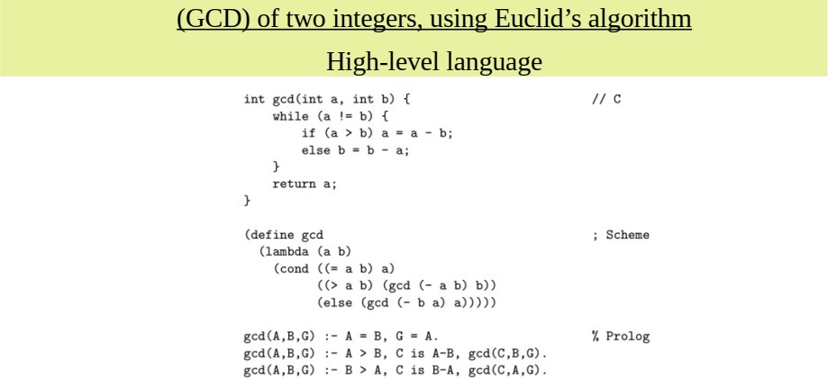
Low and High Level Languages

Slide 22
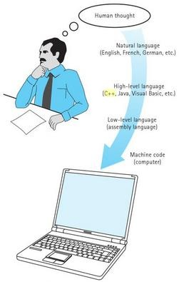
Low and High Level Languages

Slide 23
Compilation and Interpretation
Compilers :
  The compiler translates the high-level source program into an equivalent target program (typically in machine language), and then goes away.
  All statements are translated and stored as an executable program, or object program; execution occurs later
  When written to a file in a format understood by the operating system, machine language is commonly known as object code.

Slide 24
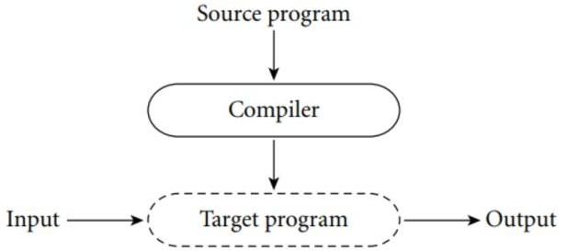
Compilation and Interpretation
Compilers :

Slide 25
Compilation and Interpretation
Interpreters :
  The interpreter reads statements in that language more or less one at a time, executing them as it goes along.
  In general, interpretation leads to greater flexibility and better diagnostics (error messages) than does compilation.
  Each statement is translated individually and executed immediately after translation

Slide 26
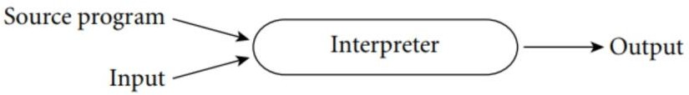
Compilation and Interpretation
Interpreters :
an interpreter is a program that reads and executes code line-by-line, without the need for compilation.
an interpreter reads each line of code, interprets it, and executes it immediately.
it does not create a machine code file that can be executed separately. Instead, the code is executed directly in memory

Slide 27
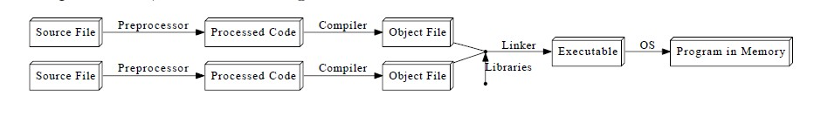
Compilation Process in C++
Preprocessor : removes comments and white space, expand abbreviations / macro and groups characters together into tokens such as keywords, identifiers, numbers, and symbols

Slide 28
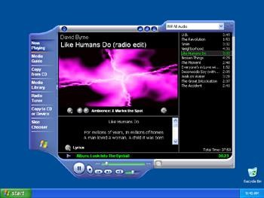

Compilation Process in C++
Linker : Combines your object code with pre-compiled object libraries for input/output etc.
Input are the object files (.obj).
Output is the executable file (.exe) in Windows.
00001111
00110011
11111111
00000000
11100111
00001111
00110011
11111111
00000000
11100111
Linker
Object File
.obj
Executable File
.exe
Library Files
.obj

Slide 29
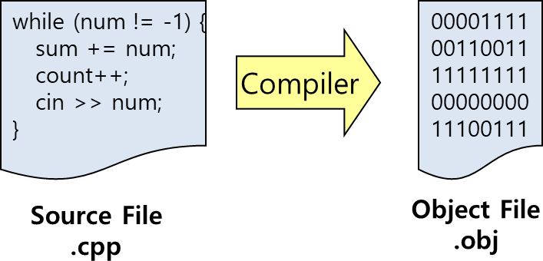
Compilation Process in C++
Compiler : Translates high-level language to machine language.
  Input to a compiler is the source code
  Output from the compiler is the object code (.obj).

Slide 30
Source Code
The programs written in a high or low-level language
It is written by the programmer.
Can be compiled automatically into object code or machine code or executed by an interpreter.
C++ source programs have extension ‘.cpp’ or ‘.h’

Slide 31

General Notes on C++
C++ is immensely popular
particularly for applications that require speed and/or access to some low-level features.
It was created in 1979 by Bjarne Stroustrup
at first as a set of extensions to the C programming language.

Slide 32
END
Of
Lecture -1

